Slide 1


Independent University, Bangladesh
Project Presentation
Course Title: Database Management
Course Code: CSE 303
Section: 04
Prepared By:
Mohammad Arshad Hossain Ratul (1930319)
Tunisha Yanoor Bristy (1930639)
Refat Ahmed Bhuiyan (1930053)
Nahin Islam (1930577)
Tasnia Tabassum Oishee (1910040)
Sadia Islam Semi (1930127)

Slide 2
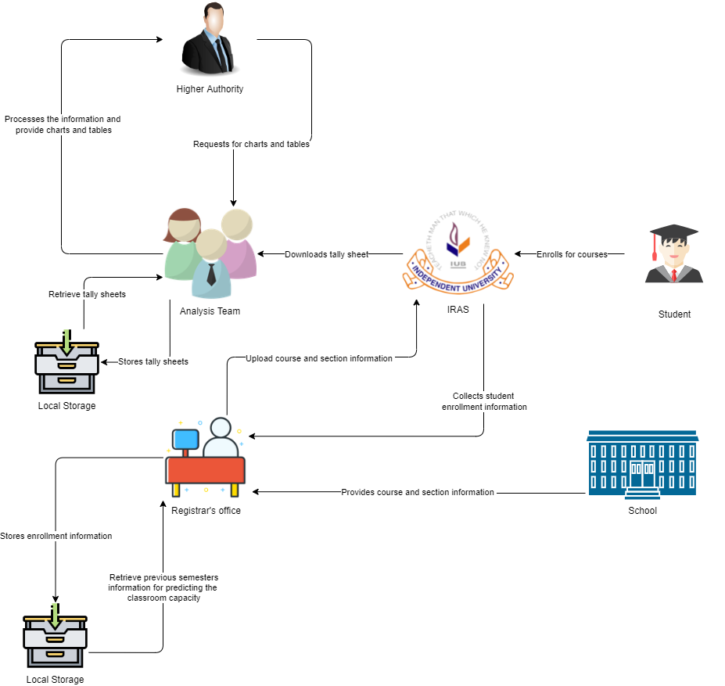
Rich Picture
Rich picture is a method of exploring, acknowledging and defining a situation and then expressing it using diagrams to form a rough mental model.
Rich picture covers identifying the issue you wish to address and develop an unstructured description of the situation
Rich picture of EXISTING Business System
Figure 1: Rich Picture AS-IS

Slide 3
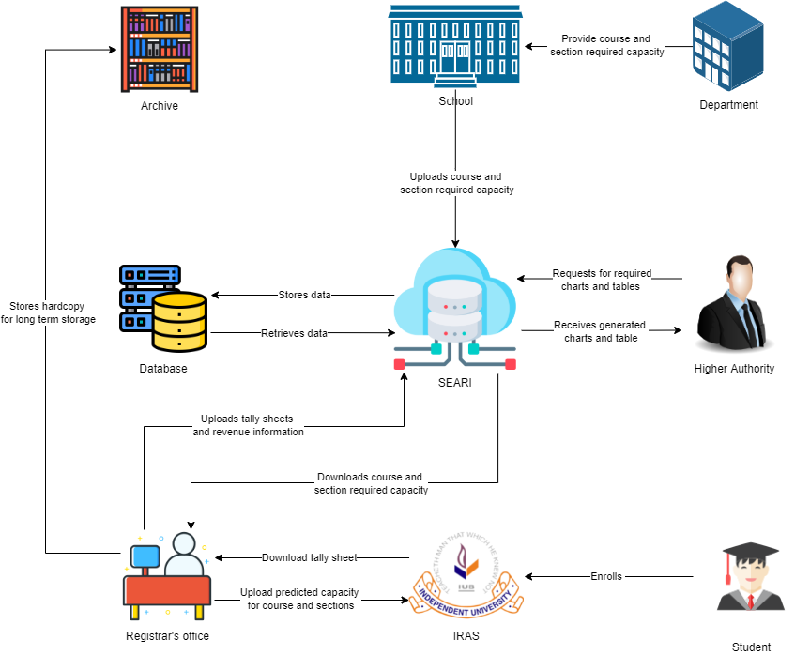
Rich Picture
Rich picture of Proposed Business System
In Rich picture existing system, the work is done by human directly but in proposed system it is more advanced and better, and the works are done more accurately by the help of a better database.
Most of the manual tasks are automated in the proposed system.
Figure 2: Rich picture of proposed system

Slide 4
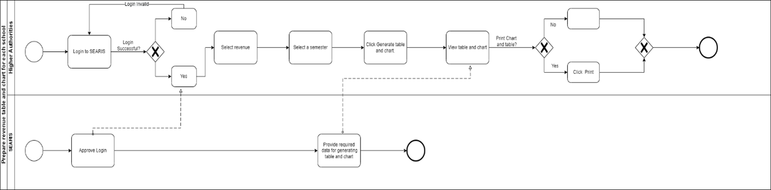
Business Process Diagram (TO-BE)
Business Process Modelling Notation (BPMN) offers an excellent format for business users while yet being capable of representing sophisticated process concepts.
From start to finish the BPMN notation represents the steps of a planned business process
BPMN data includes data objects, data inputs, data outputs and data stores
The processed BPMN shows the advanced and solved business process.
Figure 3: Prepare revenue table and chart for each school (TO-BE)

Slide 5
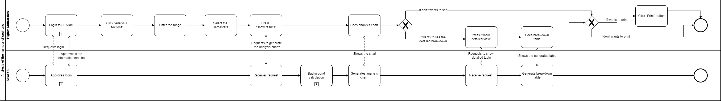
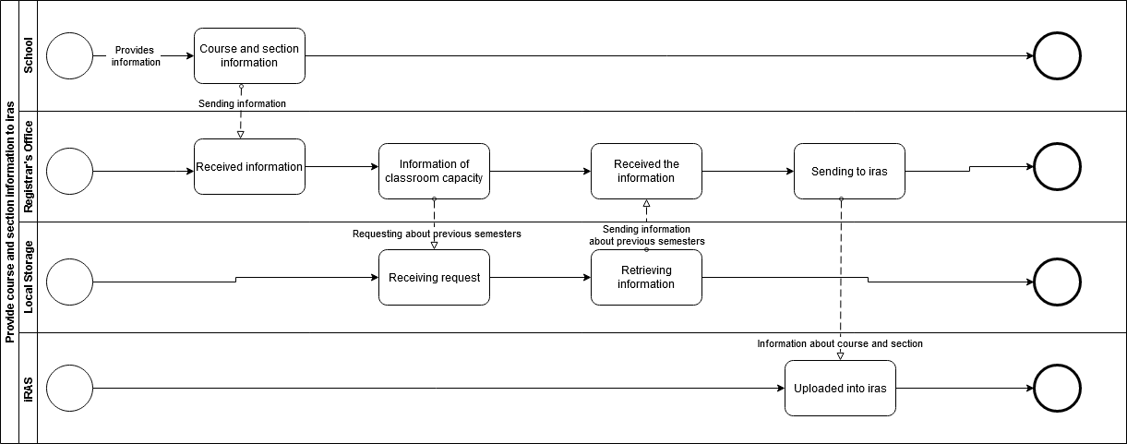
Business Process Diagram (TO-BE)
Figure 4: Analysis of number of section (TO-BE)
Figure 5: Provide course and section information to SEARIS (TO-BE)

Slide 6
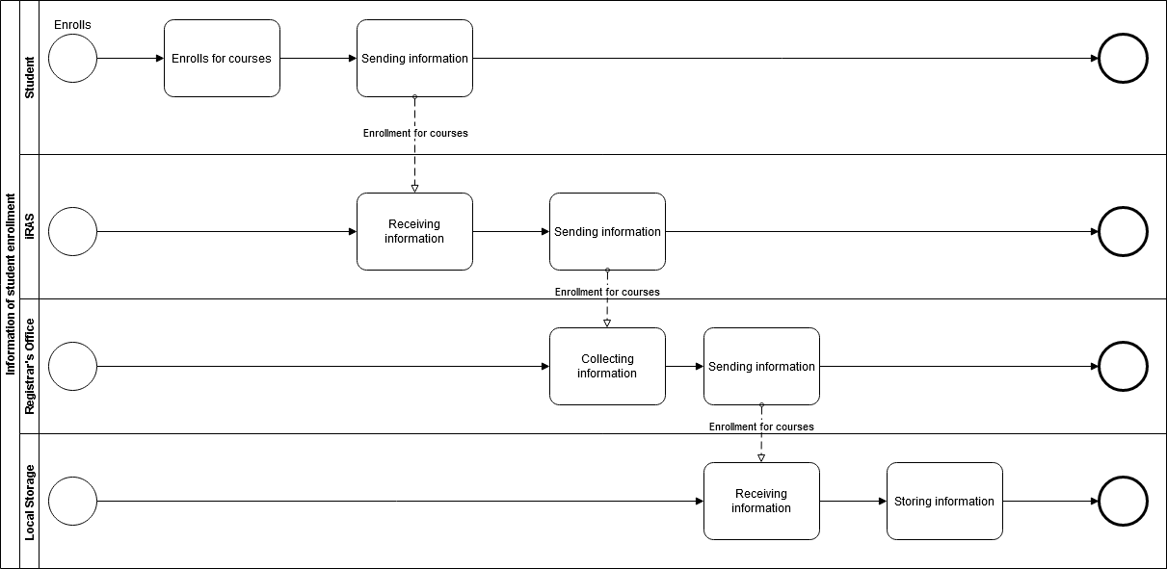
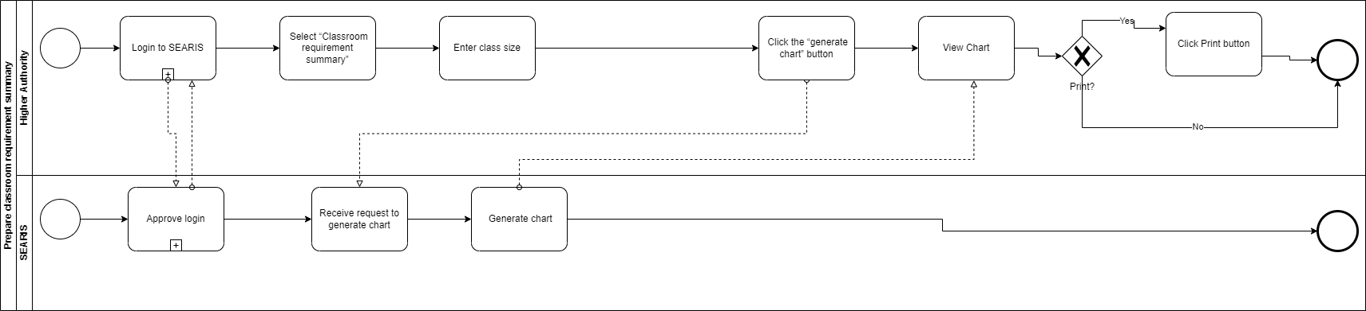
Business Process Diagram (TO-BE)
Figure 6: Information of student enrollment (TO-BE)
Figure 7: Prepare classroom requirement summary (TO-BE)

Slide 7
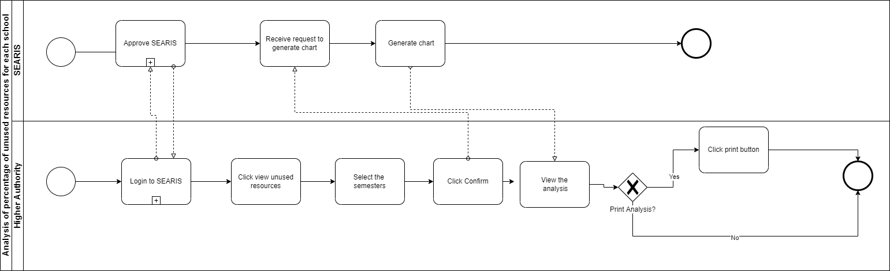
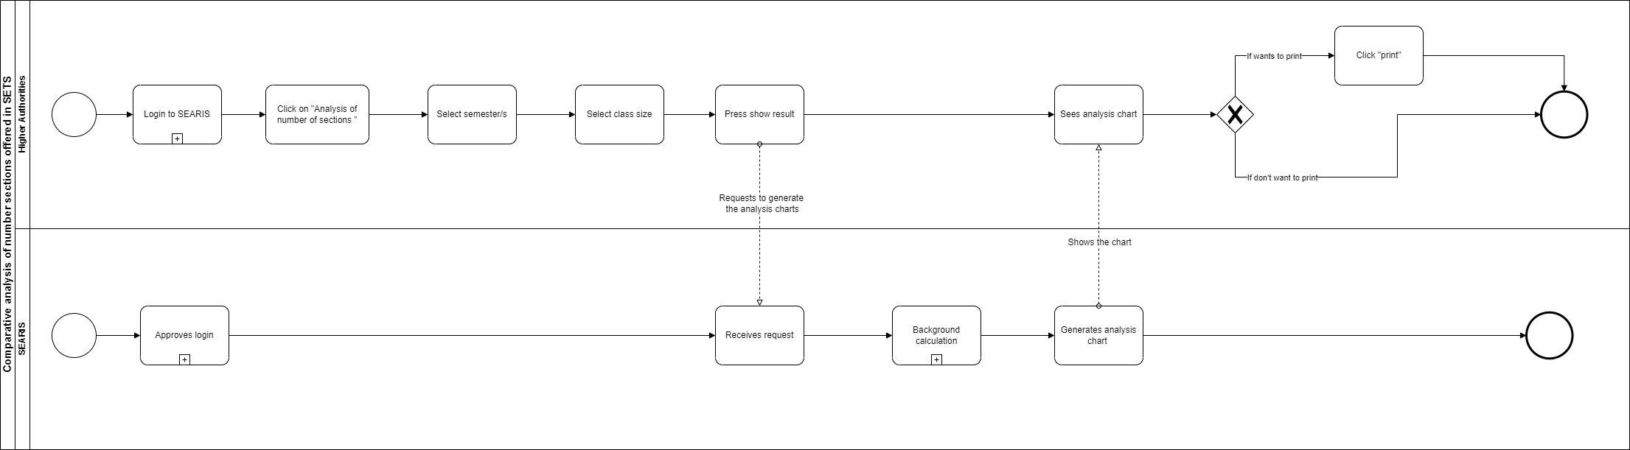
Business Process Diagram (TO-BE)
Figure 8: Analysis of percentage of unused resources for each school (TO-BE)
Figure 8: Comparative analysis of number sections offered in SETS (TO-BE)

Slide 8
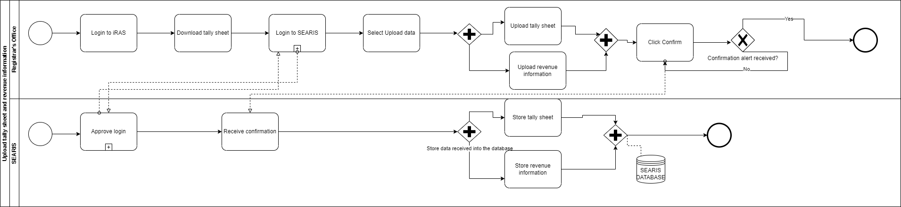
Business Process Diagram (TO-BE)
Figure 9: Upload tally sheet and revenue information (TO-BE)

Slide 9
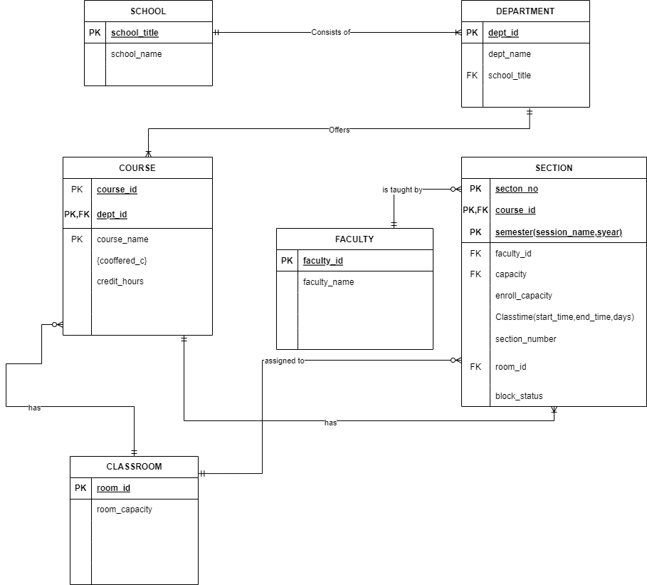
Entity Relation Diagram (ERD)
An entity relationship diagram (ERD) , often called an entity relationship model , is a graphical depiction of relationships between people, objects, places, concepts and events in an information technology (IT) system
To illustrate the contents of a data store, ERD diagrams are frequently used in connection with a data flow diagram
ERD is a tool that allows us to visualize database design concepts by generating ER diagrams.
In an ER diagram, we can spot faults and design problems and corrections before implementing the changes in the database.
ER diagrams define the types of data that will be stored, such as entities and their attributes. They also demonstrate how entities interact with one another.
Figure 10: Entity Relation Diagram

Slide 10
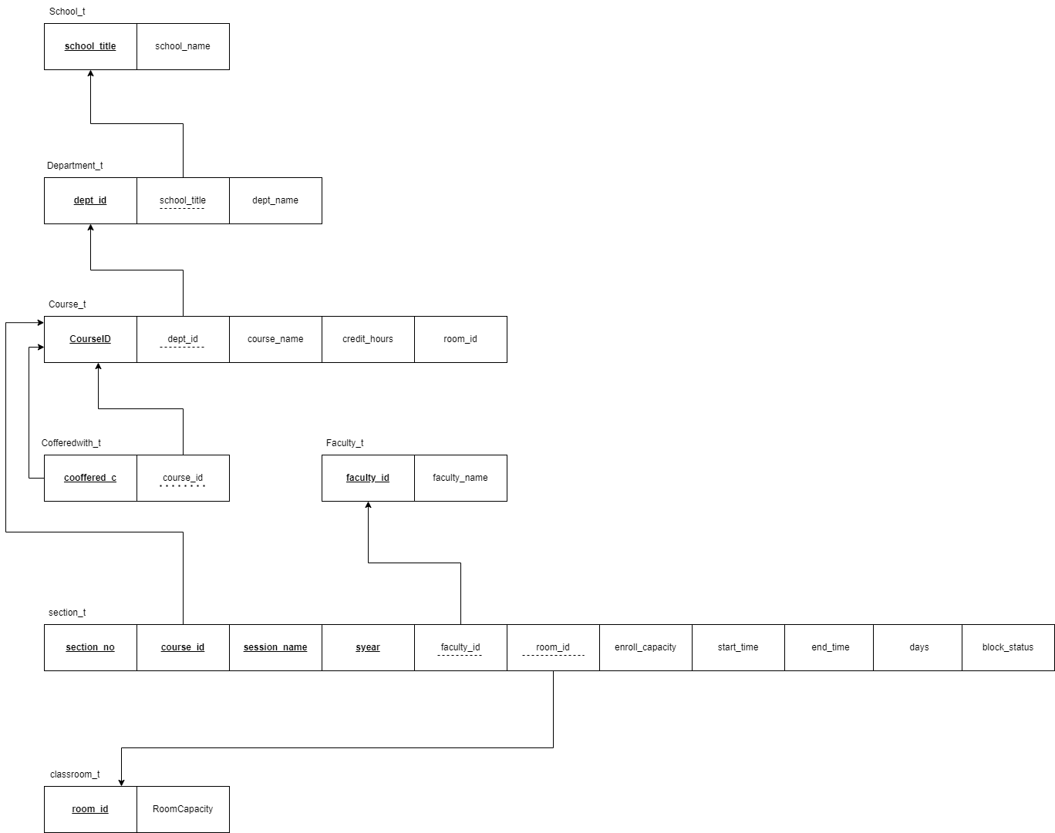
Relational schema
A relational schema is a collection of interconnected relational tables and associated elements.
A relational schema is a database structure design that represents the data that will be entered into the database and describes how that data will be organized in tables called relations in relational schemas.
The schema explains how the tables are related to one another. The relational model's goal is to provide a logical technique for expressing data and queries, allowing users to stare precisely what information the database has and what information they desire from it.
Figure 11: Relational Schema

Slide 11

Thank You
Any QUESTION ?

